Slide 1
CS118 - Programming Fundamentals Introduction to C++
Waqas Ali
Lecturer (CS)
National University of Computer and Emerging Sciences
waqas.ali@nu.edu.pk

Slide 2
Switching to another language
Why switch?
Some fundamental concepts of programming can be explained better in C/C++
Understanding of transition from one language to another will help
Why C/C++
Better understanding of how machine works
Can be used for systems programming
May be used in other courses

Slide 3
C/C++
C and C++ are two different languages
C++ is an extension of C
Both C and C++ are compiled languages
Recall that, a compiler scans the entire program and translates the whole of it into machine code at once
On the other hand, an interpreter translates just one statement of the program at a time into machine code

Slide 4
Tools
Compiler
Examples
Microsoft C++ Compiler (used with Microsoft Visual Studio)
GNU C++ Compiler (g++)
Interactive Development Environment (IDE) or a Text Editor
Examples
Codeblocks
gedit (default text editor in ubuntu)
Visual Studio Code (Learn how to setup here)
Dev C++
Atom
Sublime text
Microsoft Visual Studio

Slide 5
Getting the g++ compiler on Ubuntu
Run the following command to update your package list:
sudo apt-get update
In order to install the GNU g++ compiler, run the following command:
sudo apt-get install g++
* g++ is preinstalled on some ubuntu versions

Slide 6
Codeblocks on ubuntu
Open the ubuntu software center and type codeblocks in the search bar.
It may not work occasionally.
Alternative method: run the following command:
sudo apt-get install codeblocks

Slide 7
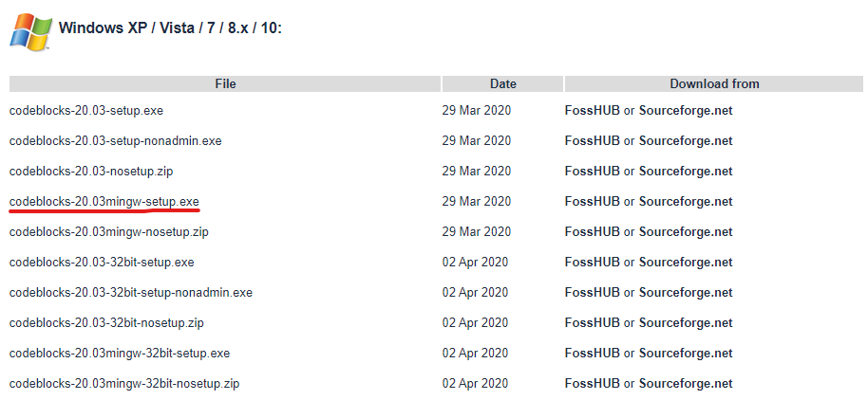
Codeblocks on windows
Go to: http://www.codeblocks.org/downloads/binaries
Download the file marked in the following screenshot:
After installing using this file you will the GNU g++ compiler as well as the Codeblocks IDE.

Slide 8
Compile/Run your code without an IDE
Write your code in any text editor of your choice and save it in a directory. Let us consider we saved the file by the name hello.cpp.
On windows open the command prompt, on linux open the terminal.
Navigate to the directory where you saved your code and type the following command to compile your code:
g++ hello.cpp –o hello
Where g++ is the command
hello.cpp is the filename to be compiled
The -o tells the compiler to output an executable program named hello (written after the –o, can be any name)

Slide 9
Compile/Run your code without an IDE
To run your code
On linux, on the terminal type the name of the output file in the following way:
./hello
On windows, on the command prompt, type the name of the output file in the following way:
hello
* Considering hello is the name of the output file in both cases

